Slide 1

Māori values

Slide 2
Māori values
Treaty settlements have helped create an increase in business opportunities for Maori.
Many modern Maori businesses operate with Maori culture, values, and tradition, alongside modern techniques and technologies. Maori ways of practising business play a significant role in the business culture of New Zealand.
Many Maori practises are also becoming part of mainstream culture and practises.

Slide 3
Māori values
Measuring success in Maori business
Ability to establish a clear point of difference.
Increased positive reputation (mana) amongst peers.
Ability to make a profit .
Application of profits to support the notion of a collectivist society .
Levels of success in supporting a network of strategic co-operation with others.
Conservative levels of debt in relation to equity.
Substantial levels of retained earnings to provide funding for future opportunity exploitation.

Slide 4
Māori values
The Maori worldview:
An open system in which the spiritual realm interacts with the physical world and vice versa. Myths and legends support a holistic view not only of creation but of time and of peoples (Irwin, 1984).
The world is viewed as a whole and cannot be understood through being compartmentalised or dissected, knowledge is acquired through taking a holistic approach (Murton, 1987).
This resulted in sustainable environmental management practices in which Maori see themselves as part of nature rather than superior to it.

Slide 5
Māori values
Important values in Maori culture:
These values and beliefs influence the organisational culture & business practices of businesses owned and run by Maori.
Manaakitanga – Hospitality.
Whakahihi – Pride.
Whakapapa - Genealogy, ancestry.
Whanaungatanga - Family relationships, the importance of family.
Rangatiratanga – The right to exercise authority, chiefly autonomy, chiefly authority, ownership, or leadership of a social group.
Mana - Spiritual authority and power.
Tapu – A system for the regulation of conduct; it sacralises and sets apart things with which the ordinary individual should not meddle.

Slide 6
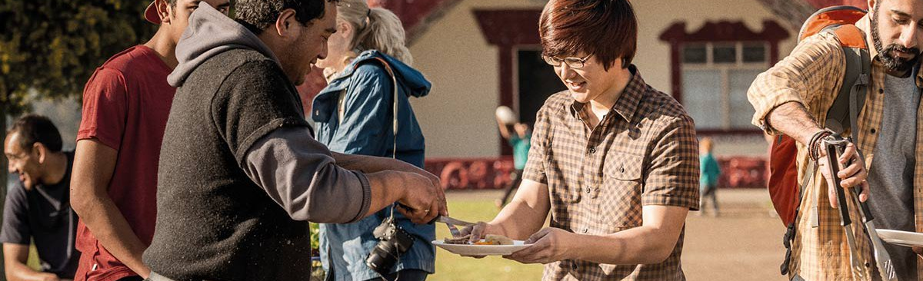
Māori values
Manaakitanga:
This principle means a group or organisation should be able to host and provide for people appropriately. Resources must be allocated for this purpose. Hosting may involve large groups of owners and visitors. Whānau may be expected to support this function. There is an important saying: “With my food basket and your food basket we will feed the people.” This expresses an obligation.

Slide 7
Māori values
Whanaungatanga:
This principle acknowledges the importance of networks and relationships and, therefore, of developing, managing, and sustaining relationships. It involves caring for and working harmoniously with others to achieve common goals using relational strategies such as tuakana-teina. Whanaungatanga is expressed in a variety of ways in business settings; for example: culture, whānau-model systems and structures, support for and employment of whānau, use of whānau networks, and whānau support for the business. A downside is that a sense of obligation to whānau, and whānau expectations, can create problems for a business.

Slide 8
Māori values
Kaitiakitanga:
This principle is about responsible environmental management and sustainable enterprise. It includes the taking care of assets for future generations, as opposed to ownership and the right to divest assets. As kaitiaki or guardians, the owners or trustees of an enterprise are responsible for protecting (and/or growing) resources for future generations – not just for short-term or individual profit.

Slide 9
Māori values
Rangatiratanga:
This principle is about exercise of leadership, authority, guardianship, and ownership rights; particularly focused on resource production, utilisation, and management for current and future requirements. This includes strategic development and oversight, relationship development and maintenance, problem-solving, conflict resolution and peace-making, adaptation, risk analysis, and management.

